Slide 1
Can A Machine Detect Colour?
By: Aishwarya Ramanathan

Slide 2
Colour Detection Workflow (5 steps)
Remove Background Pixels
Detect colours in remaining pixels (incidental pixels)
Detect frequency of each colour
Calculate percentage of each colour based on total incidental pixels
Threshold Values for optimum colour selection

Slide 3
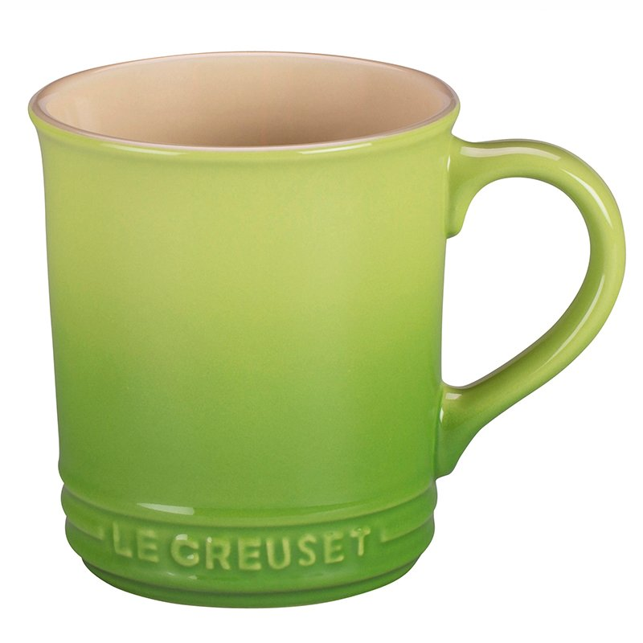
Today’s Subject
LE CREUSET RUSTIC MUG - PALM

Slide 4
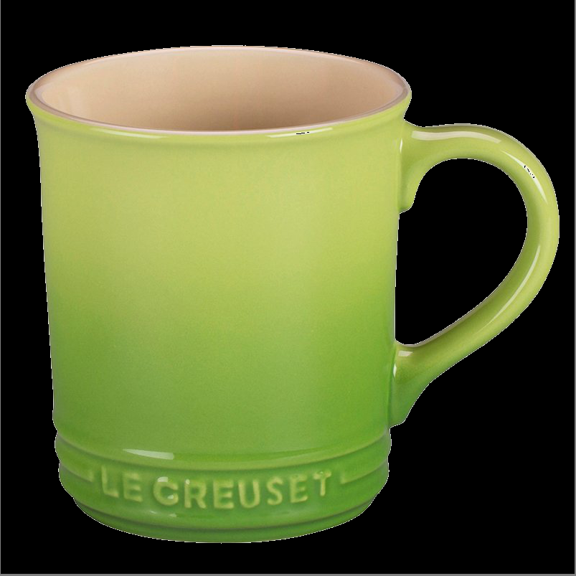
Step 1/5: Remove Background Pixels

Slide 5
Step 2/5: Detect Colours In Pixels

Slide 6
Step 3/5: Detect Frequency of Each Colour
Total Pixels: 355786
Green: 192244
Yellow: 95893
Grey/White: 44742
Pink: 14285
Brown: 10514
Orange: 75
Black: 32
Blue: 1

Slide 7
Step 4/5: Calculate Percent of Each Colour
All Colours Detected:
Green: 54.0%
Yellow: 26.0%
Grey/White: 13.0%
Pink: 4.0%
Brown: 3.0%

Slide 8
Step 5/5: Various Thresholds
At least 20%
At LEAST A Difference of 20%
54% Green
26% Yellow
54% Green

Slide 9
Step 5/5: Various Thresholds
At least 20% and At LEAST A Difference of 20%
At least 20% OR At LEAST A Difference of 20%
54% Green
26% Yellow
13% Grey/White
54% Green

